Slide 1
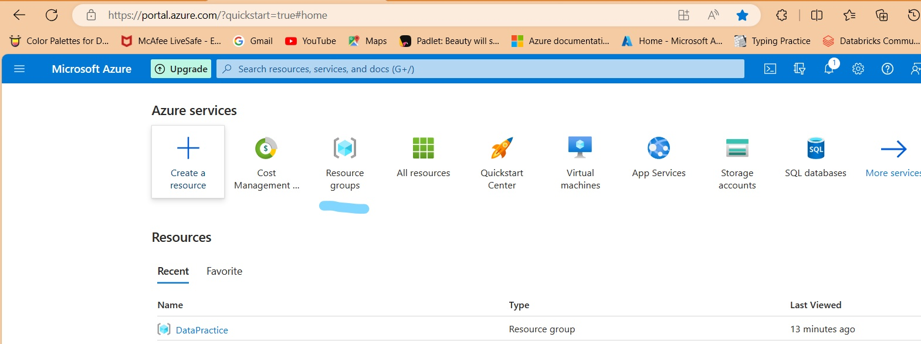
Creating A resource group
A resource group is a location where a group of user of same department share the resource and use the services, in an organization.

Slide 2
Click on create
provide the subscription
Name your resource group
Select the region
To choose a region we have to focus on
Products available by region
Azure Products by Region | Microsoft Azure
Creating a storage account
Using Storage account we store the data in azure.
There are 2 types of storage account.
4 type of storage type.
3 levels of data redundancy.
3 tires of storing files.

Slide 3
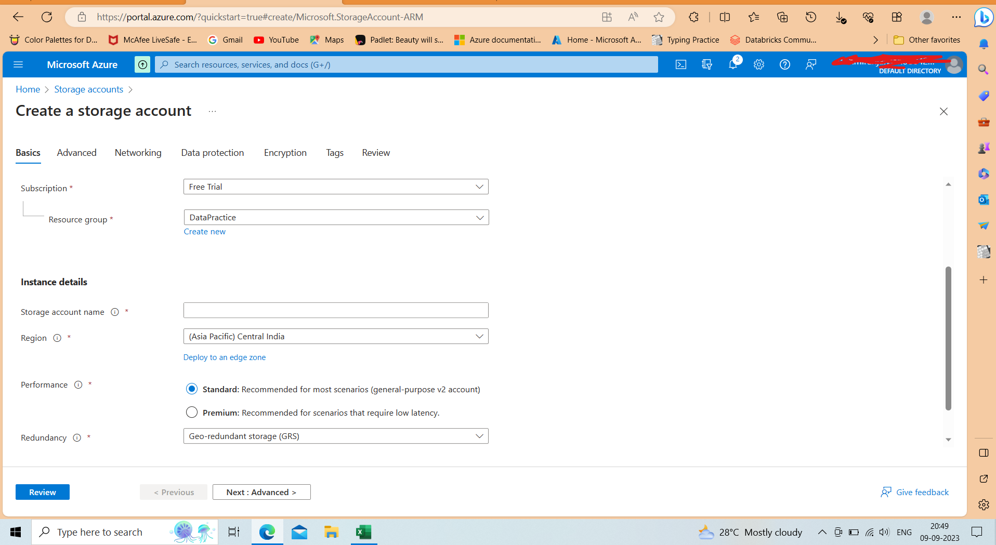

Slide 4
Choose Subscription
Choose the resource , that we create previously Data Practice
Give a storage account name , name should be unique .
Because it is going to create an URL through which we connect it from other services and account to perform any operation.
Select the region same as we provide the resource group.
Select the redundancy type.
LRS ( locally redundant storage) :
Three copies of data which is maintained within the same primary data centre.
ZRS (zone redundant storage) :
Three copies of data replicated synchronously to 3 azure availability zones in a primary region.

Slide 5
GRS
Geo Redundant Storage : This allows our data to be stored in different geographic areas of the country or world.
You get 3 copies within a primary region and places another 3 additional asynchronous copies in another region.
Performance
There are 2 types of storage account
Standard
Premium(very low latency)
Very good data movement from A to B
High I/O use case

Slide 6
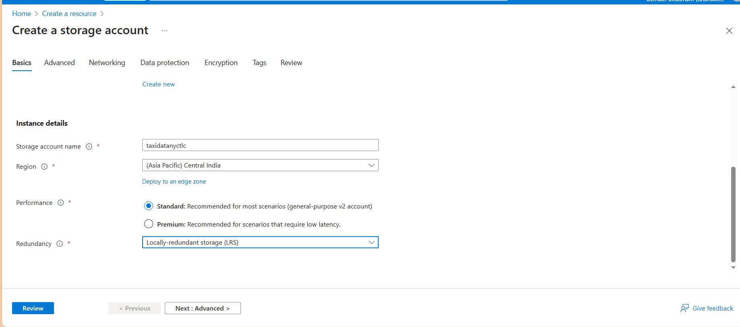

Slide 7
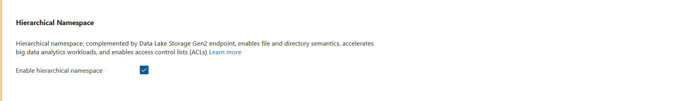
After providing the details click on next
In next page we will set access tier and convert to azure data lake gen2
Azure data lake gen2 is the combination of Hadoop and blob storage
In Azure storage account there are 4 types of storage available.
Azure blobs represented as container
Azure files
Azure queues
Azure tables
In Blob we can store 3 types of data classification
Structured
Semi-structured
unstructured

Slide 8
On this advanced page by selecting this hierarchical checklist we convert this storage account blob to azure data lake gen2.
Just there in advanced page we have option to select access tier
Hot by default selected
Optimized for storing the data that is accessed frequently
cool
Optimized for storing the data that is in frequently accessed and stored at least for 30 days (early deletion fee)
Click next ,next, review, create

Slide 9
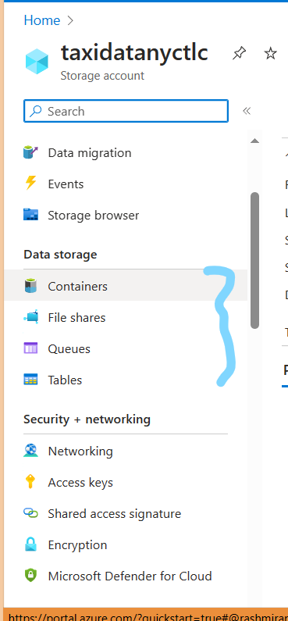
These are 4 types of storage in azure storage account.
Click on containers
+ container
Give name of the container to create one
Create
Click + add directory inside the container to add director to container
Directory is like folder inside a container.

Slide 10
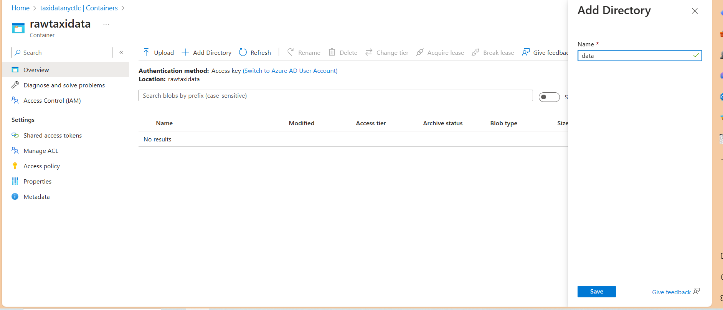
In side rawtaxidata container, we can upload the data directly or add directory to crate a folder inside that folder we can add the data .

Slide 11
Creating Data Factory
Search for data factory
Click on it
Create
Provide details
Choose subscription
Choose resource group
Give name, region, version-v2
Review and create
Using data factory we perform etl and run pipeline to store data in data lake gen2 which is non other than directory inside container in storage account.

Slide 12
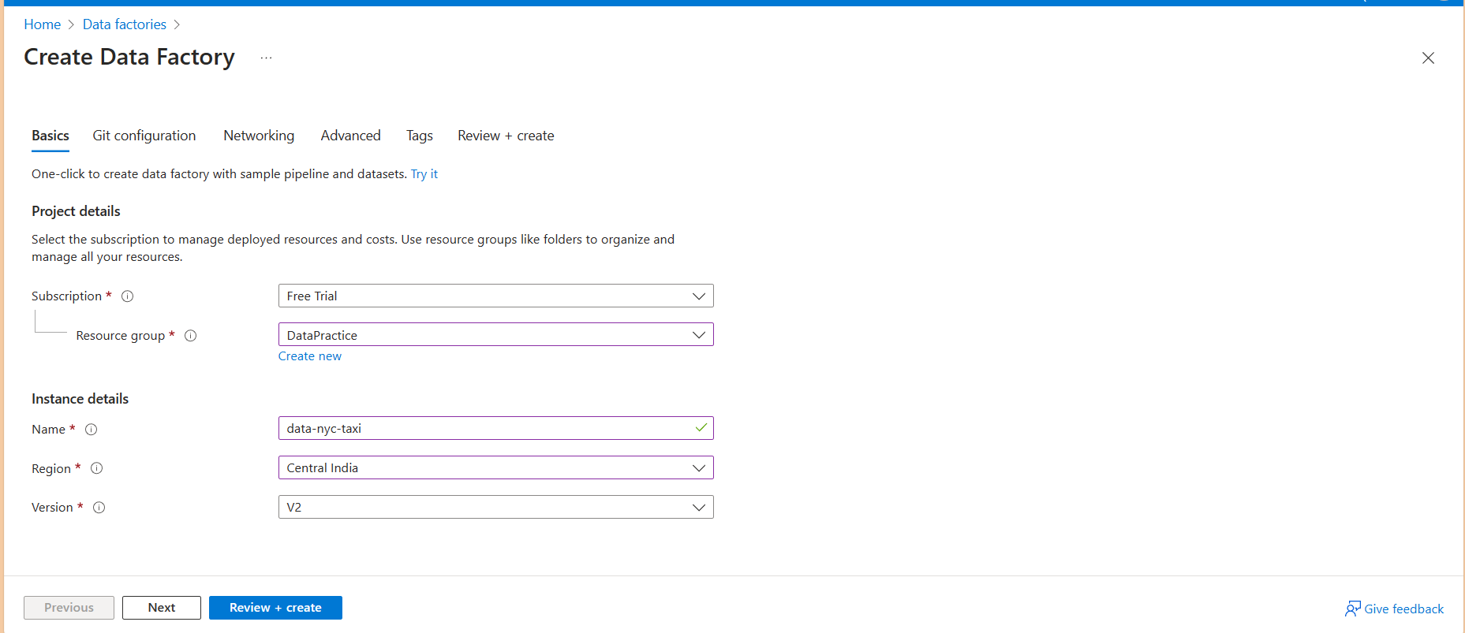

Slide 13
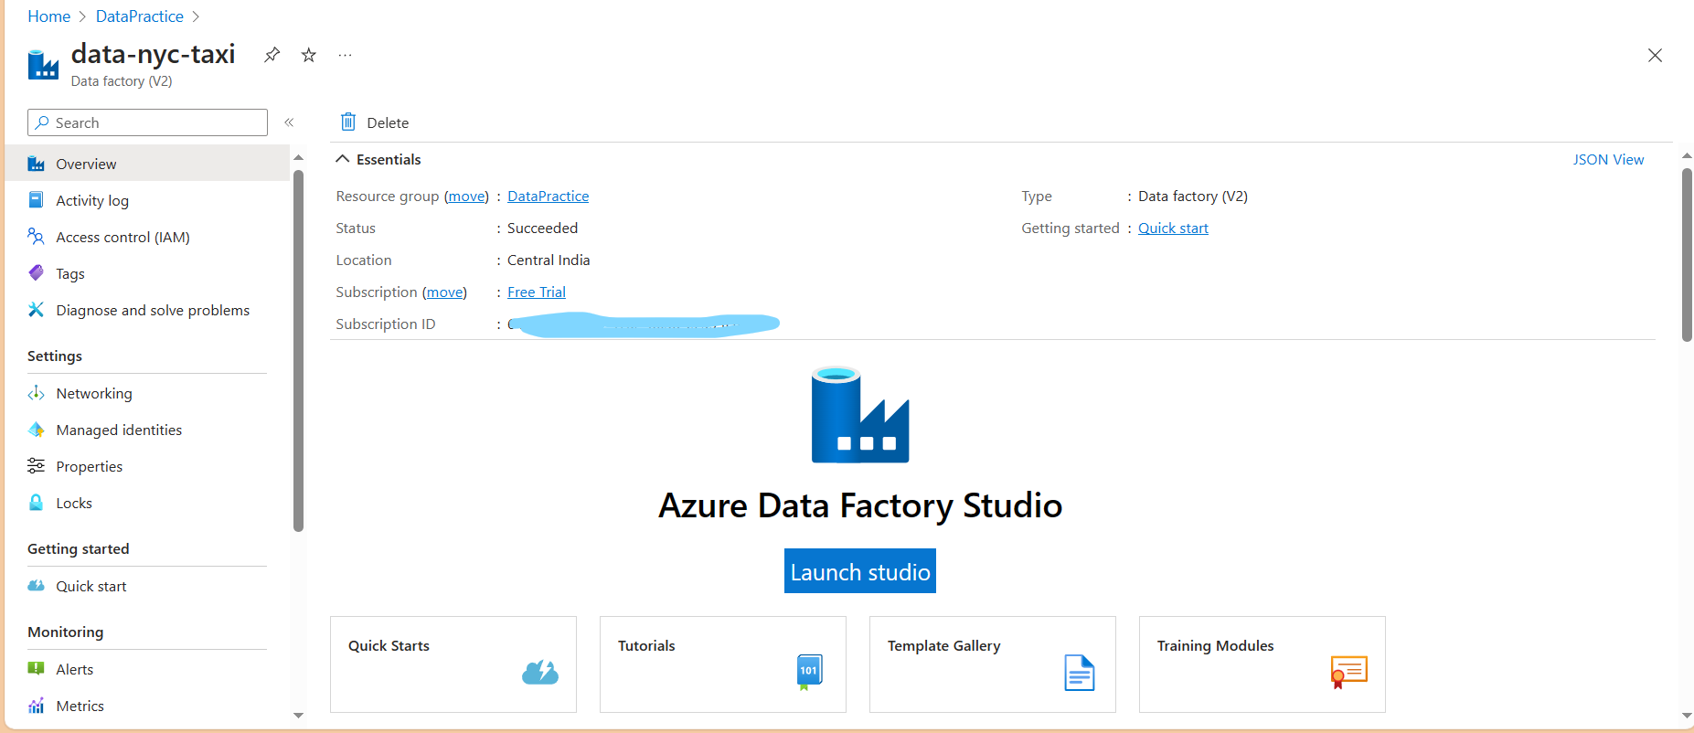
By clicking launch studio it will redirect to data factory studio page where we do all the operations.
Before launching studio, lets give the access control (IAM) to user.

Slide 14
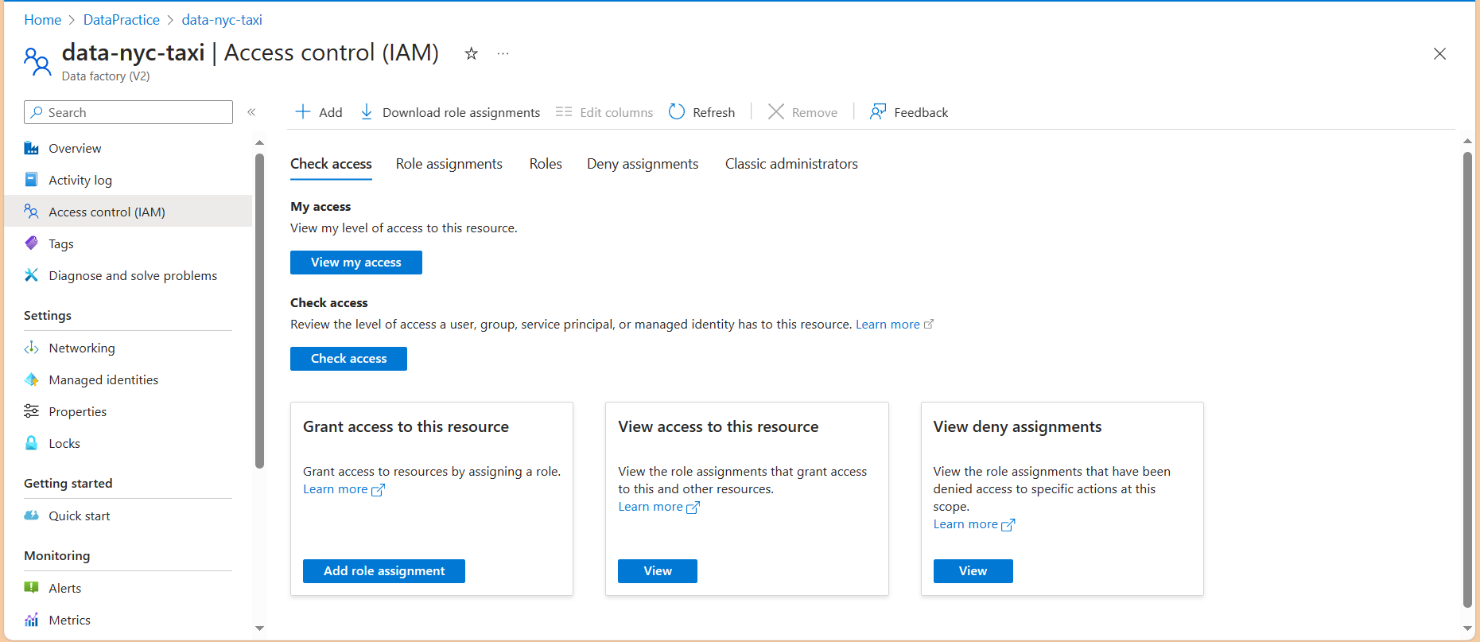
Click on access control
+ add
Select the role
Next in member + add member , select the user, next,done

Slide 15
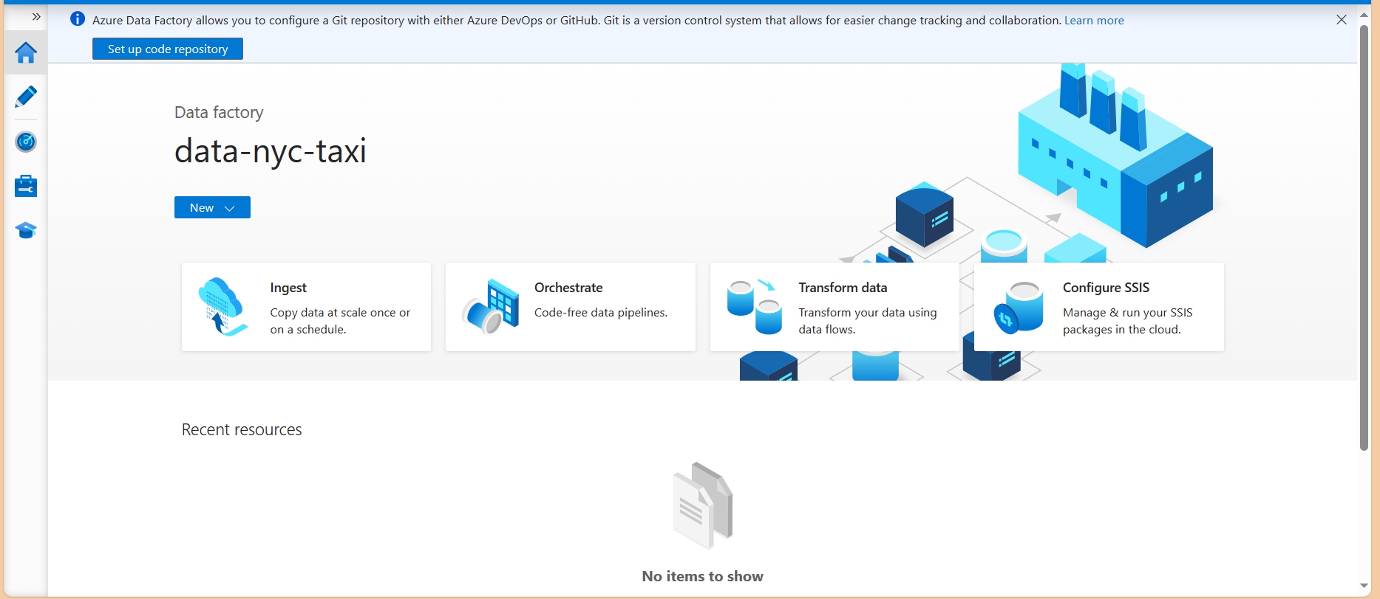
Click on launch studio.
Azure Data Factory look like this

Slide 16
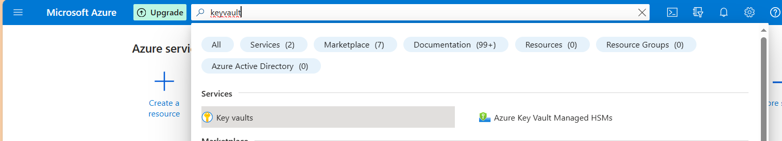
Creating Azure Key vault
Using Key Vault service , we store our keys, secrets in key vault so that when we have to give access of resource to another service we don’t need to give direct access key to that , we just use name that we provide in terms of creating a secrets or keys.
In azure data factory when we have to access storage account to store data or retrieve data , we provide the name of secrets we provide at the time of generate.
Search key vault in azure portal HOME
Select
Create

Slide 17
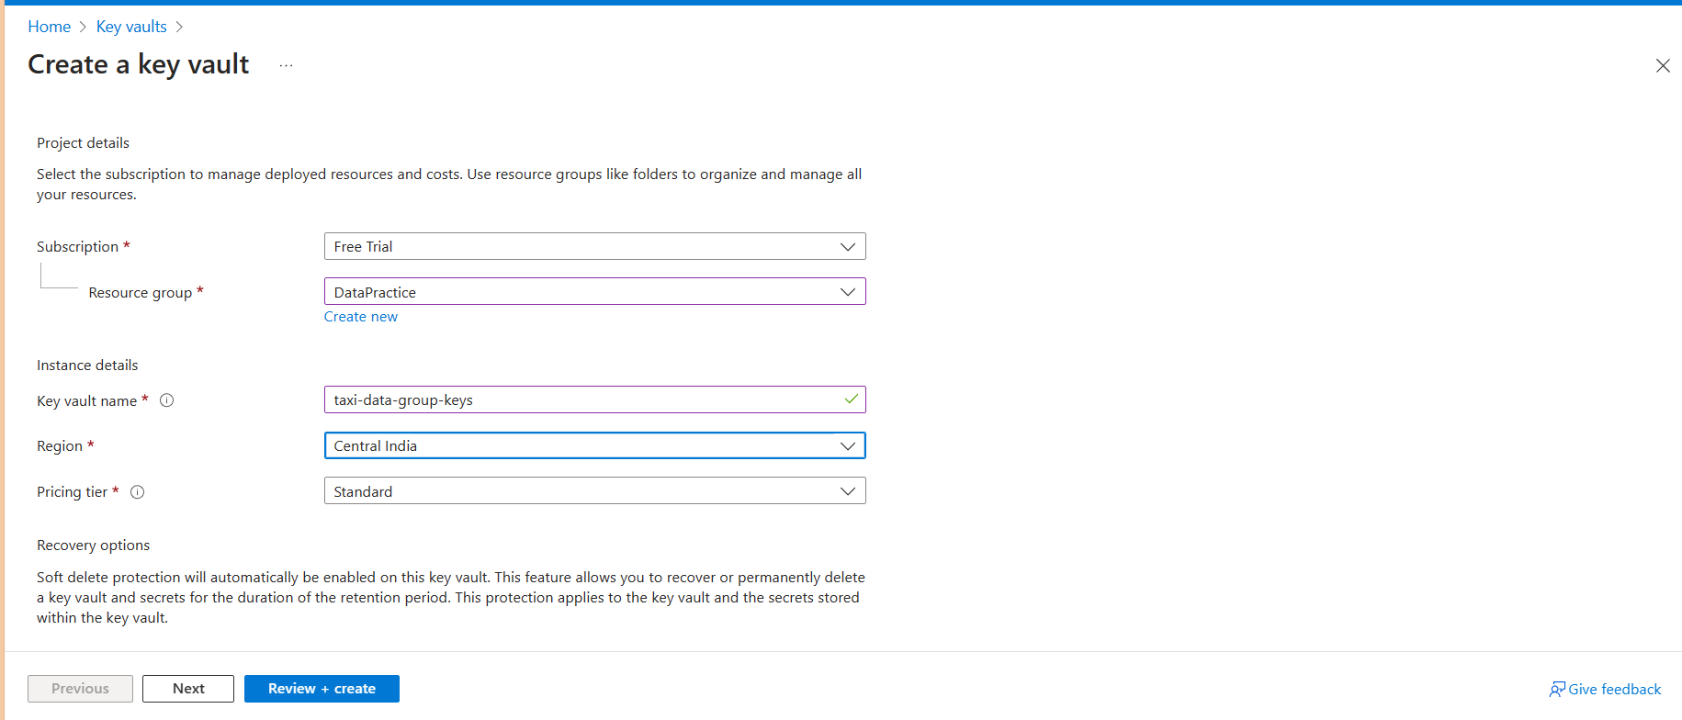
Project Details
Key vault name
Review + create

Slide 18
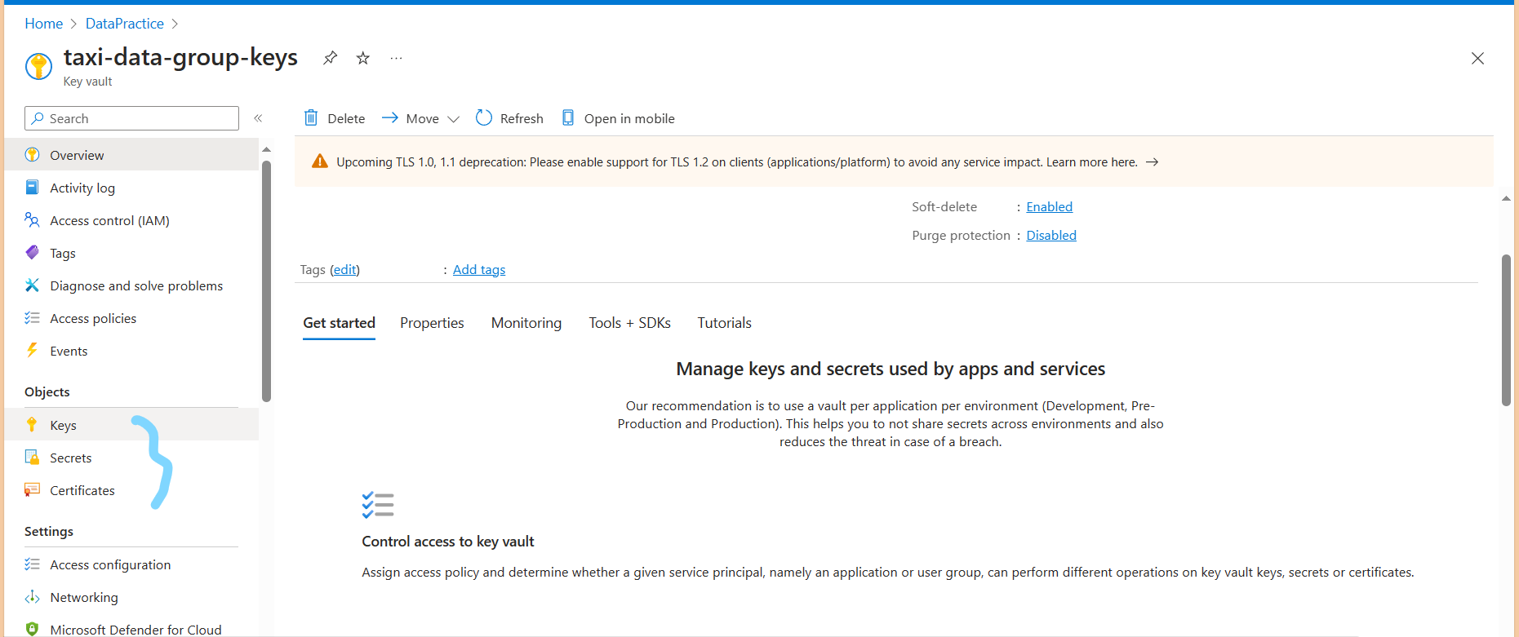
Objects
We are going to store our keys and secrets.

Slide 19
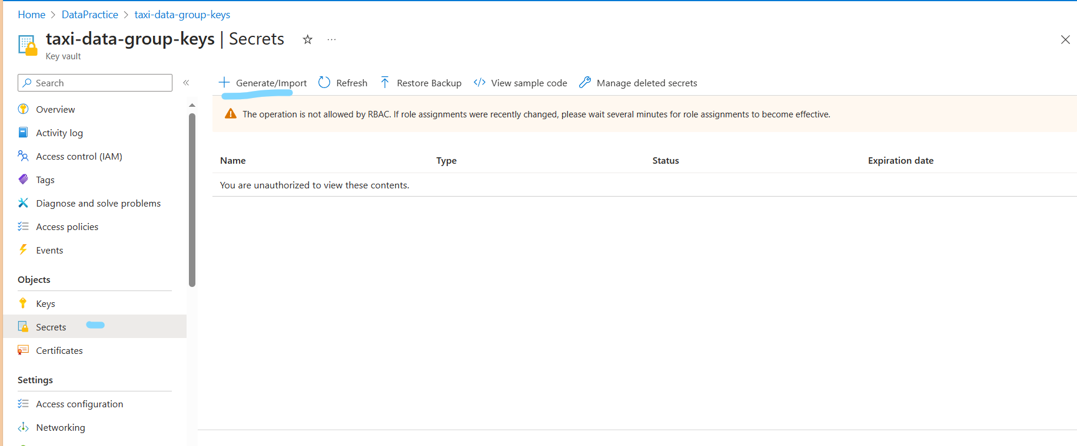
Click on secrets
+ generate/import
To add keys /secrets to key vault first give role to user in IAM

Slide 20
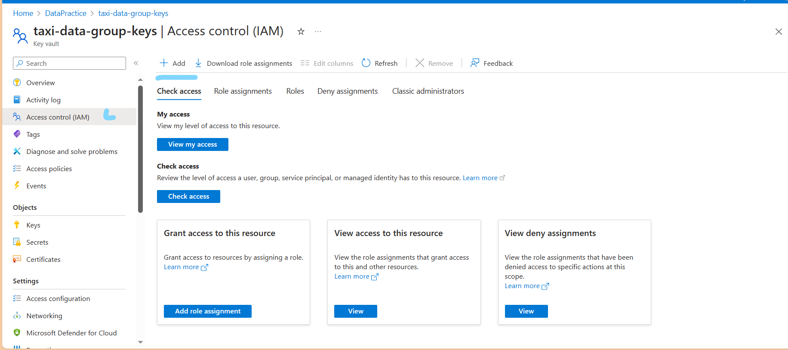
Click on IAM(access control)
Click +add

Slide 21
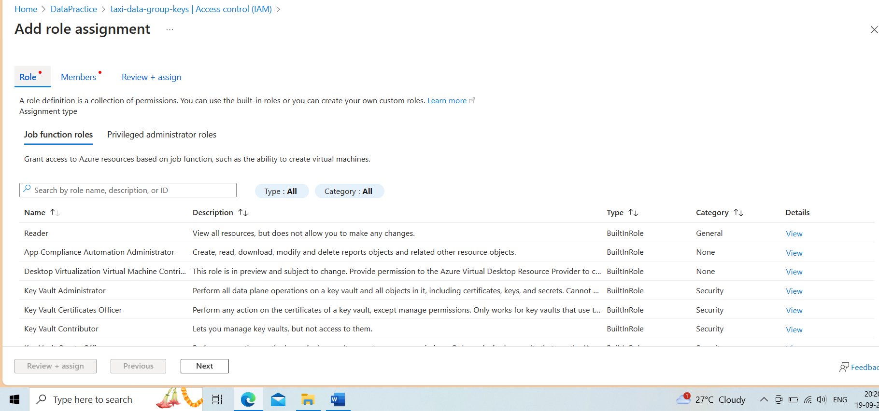
Key Vault Administrator
Next

Slide 22
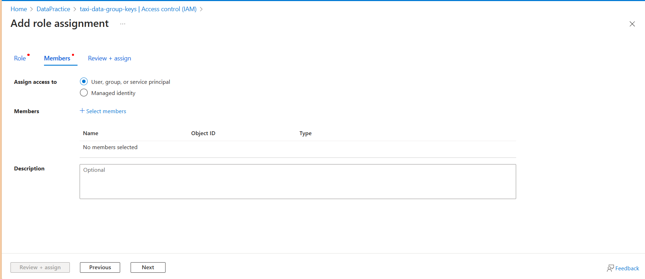
Click on +select members
It will show a list of users.
Select the user and next , review +assign

Slide 23
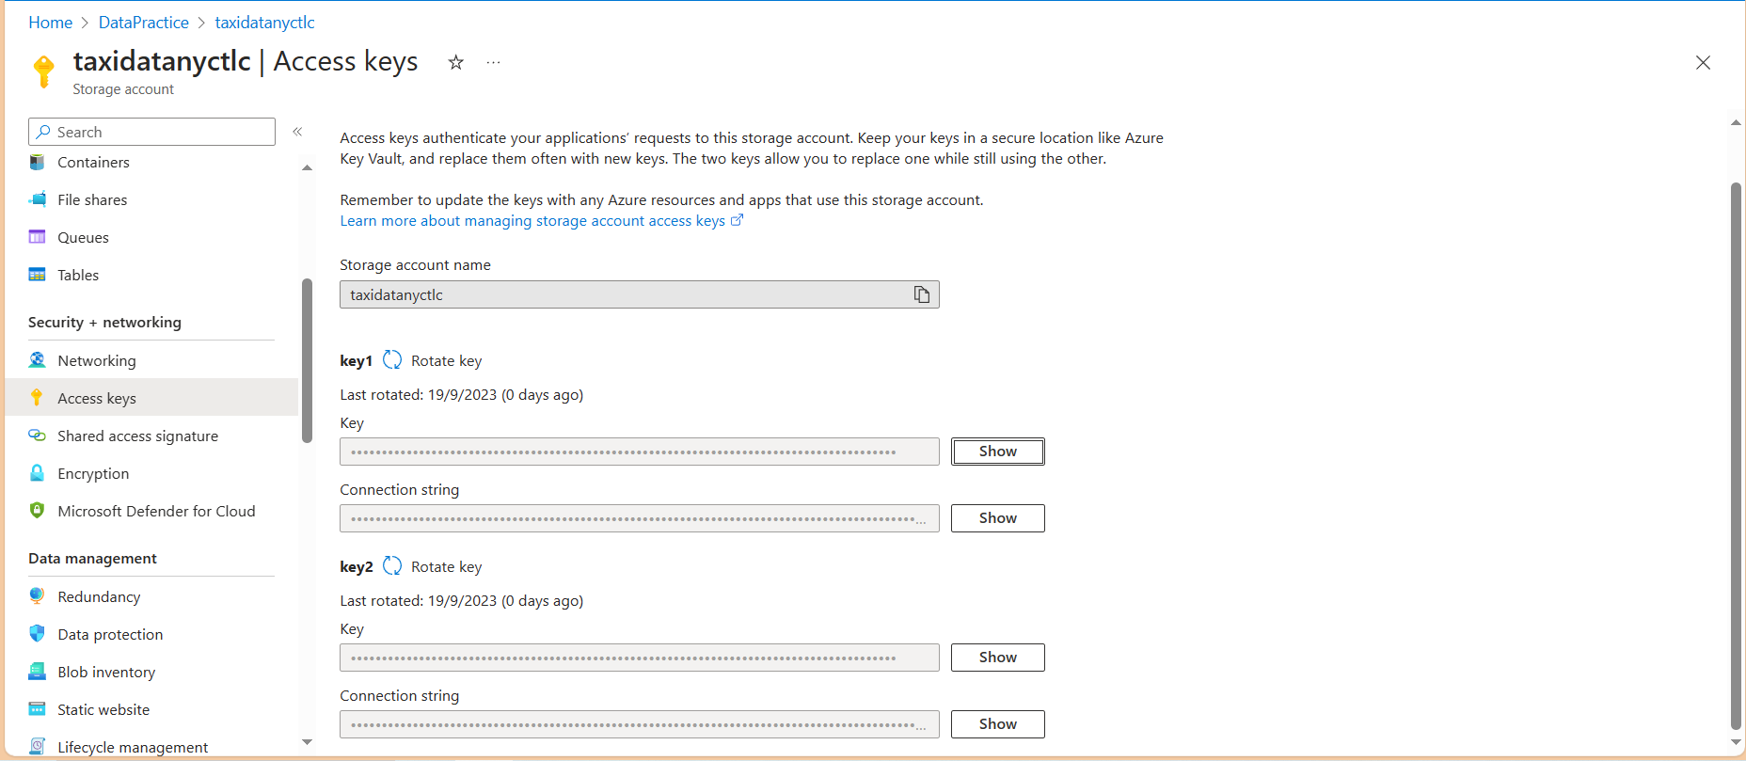
Adding storage account secrets to key Vault
Click on storage account
Click on access keys , click on show, copy the key

Slide 24
Click on key vault
Select secrets
Generate /import
It will open a window to store secret key and give a name to secret

Slide 25
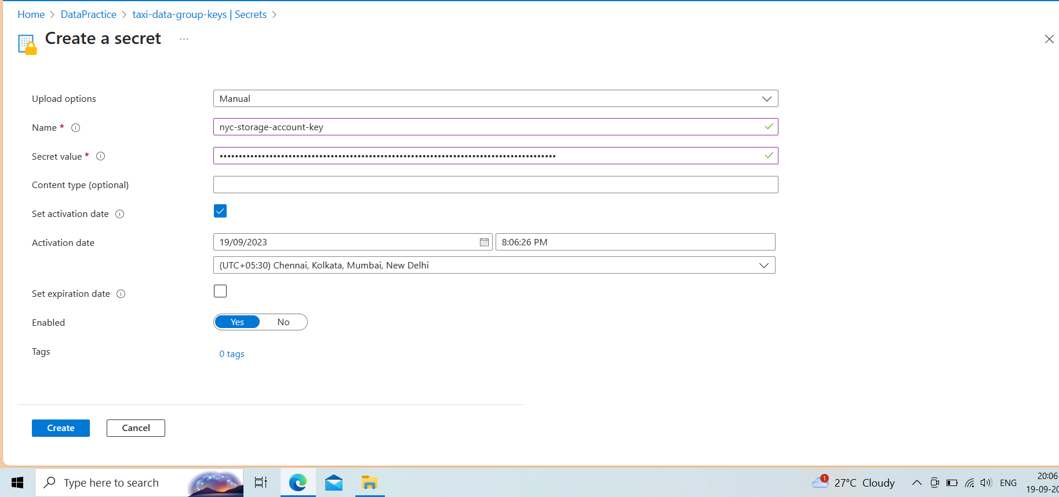
Paste the access key in secret Value
Set Activation date
Set expiration date
create

Slide 26
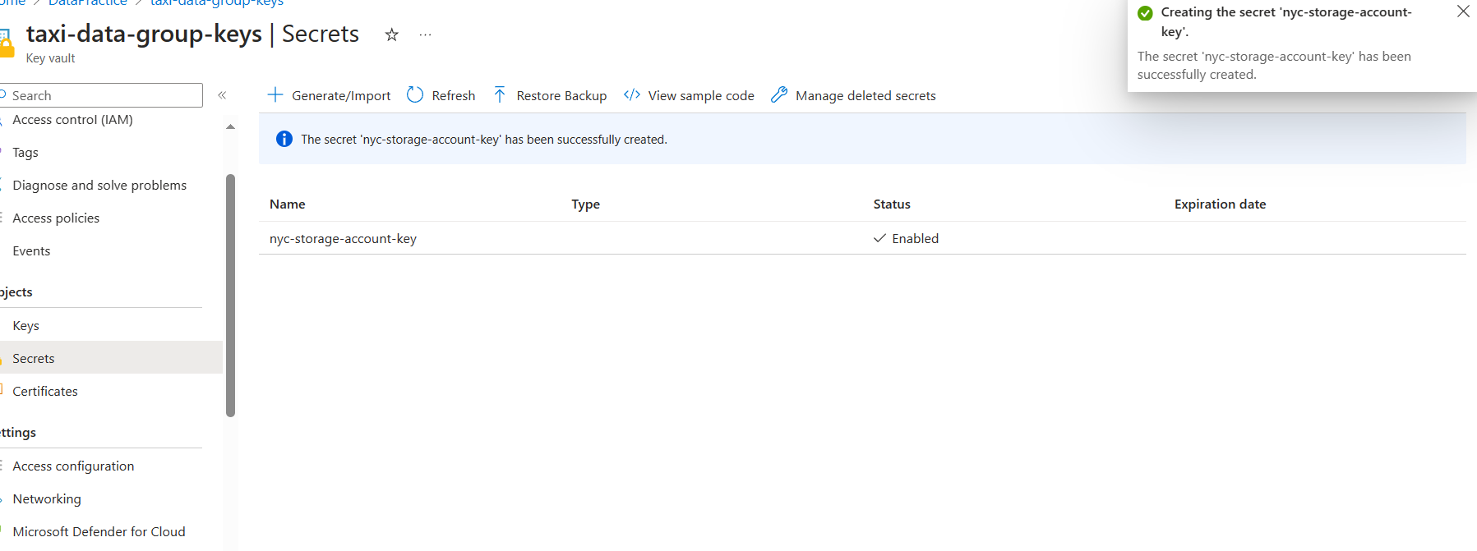
Successfully the secret ‘nyc-storage-account-key’ (name of the secret key) created

